Slide 1
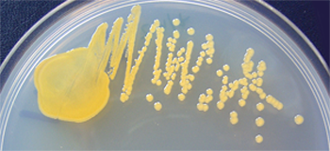
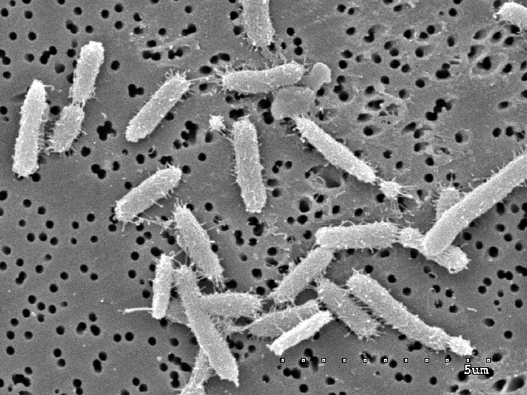
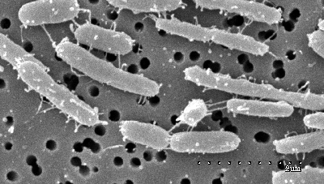
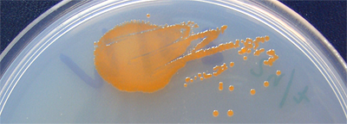

Mikrobiell oceanografi – eller, varför i all världen ska jag bry mig om celler och deras biologi?
Jarone Pinhassi
Notes:
Let me introduce you to some members of this phylum.
The bacterium forming yellow colonies is Leeuwenhoekiella blandensis and the orange one is Polaribacter dokdonensis. Many of the Bacteroidetes have quite striking colours, due to different carotenoids.
And as you see from the electron microscopy images these bacteria form long rods or even filaments.
But why then should we care about members of the Bacteroidetes phylum except for their nice colours?

Slide 2
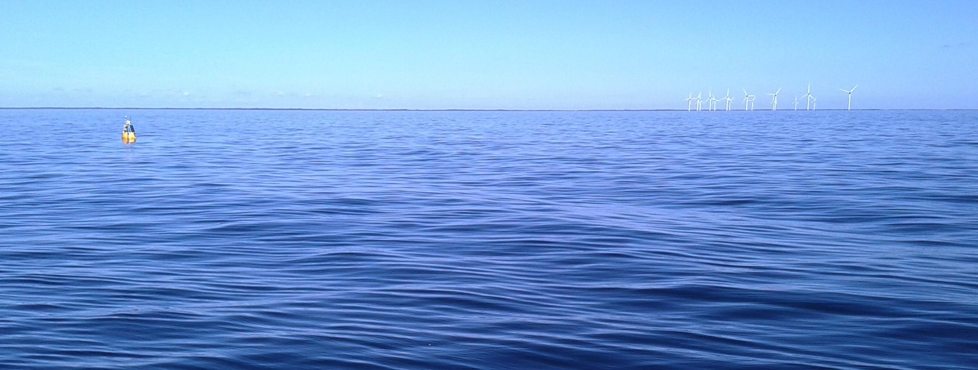
Cultivating marine model bacteria to gain insights into bacterioplankton
Jarone Pinhassi

Slide 3
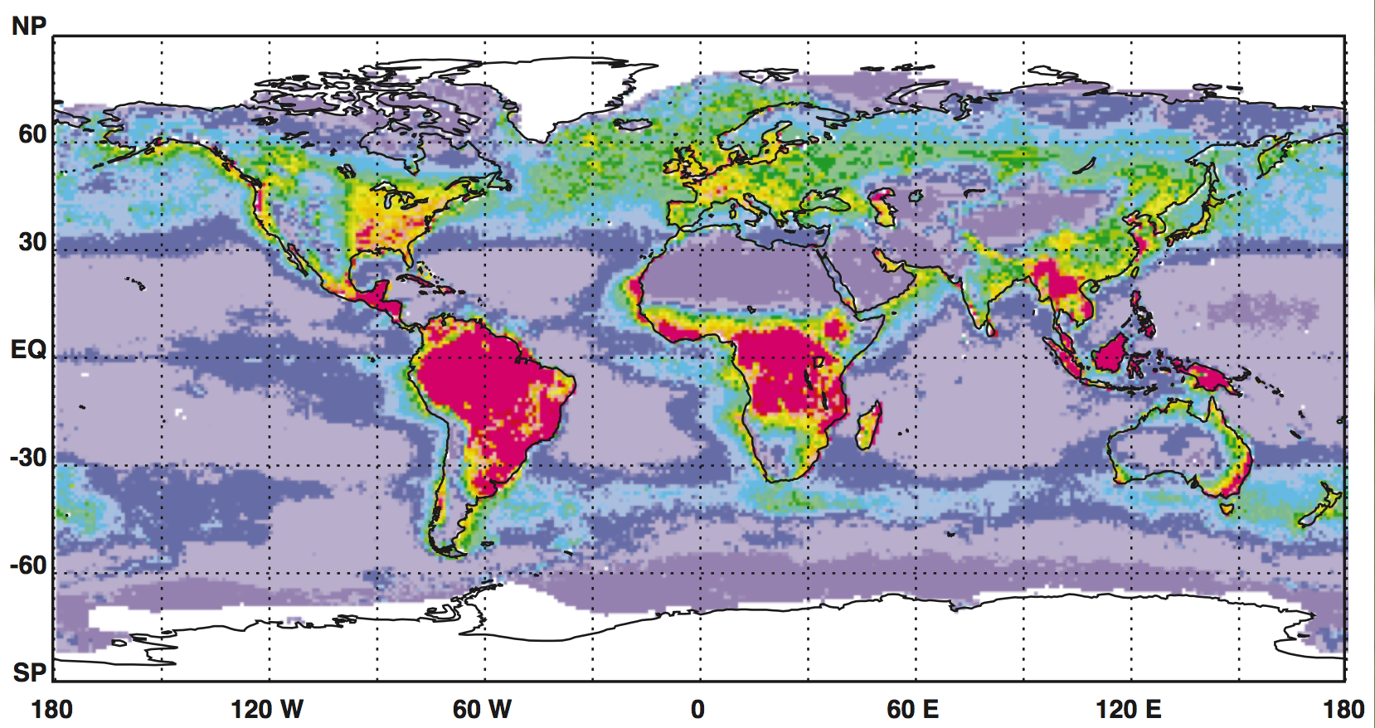
Microscopic phytoplankton in the sea carry out as much photosynthesis as green plants on land (~140 million tons of carbon per day).
Field et al. Science 1998
And around 50% of the organic matter produced is processed by marine bacteria!

Slide 4
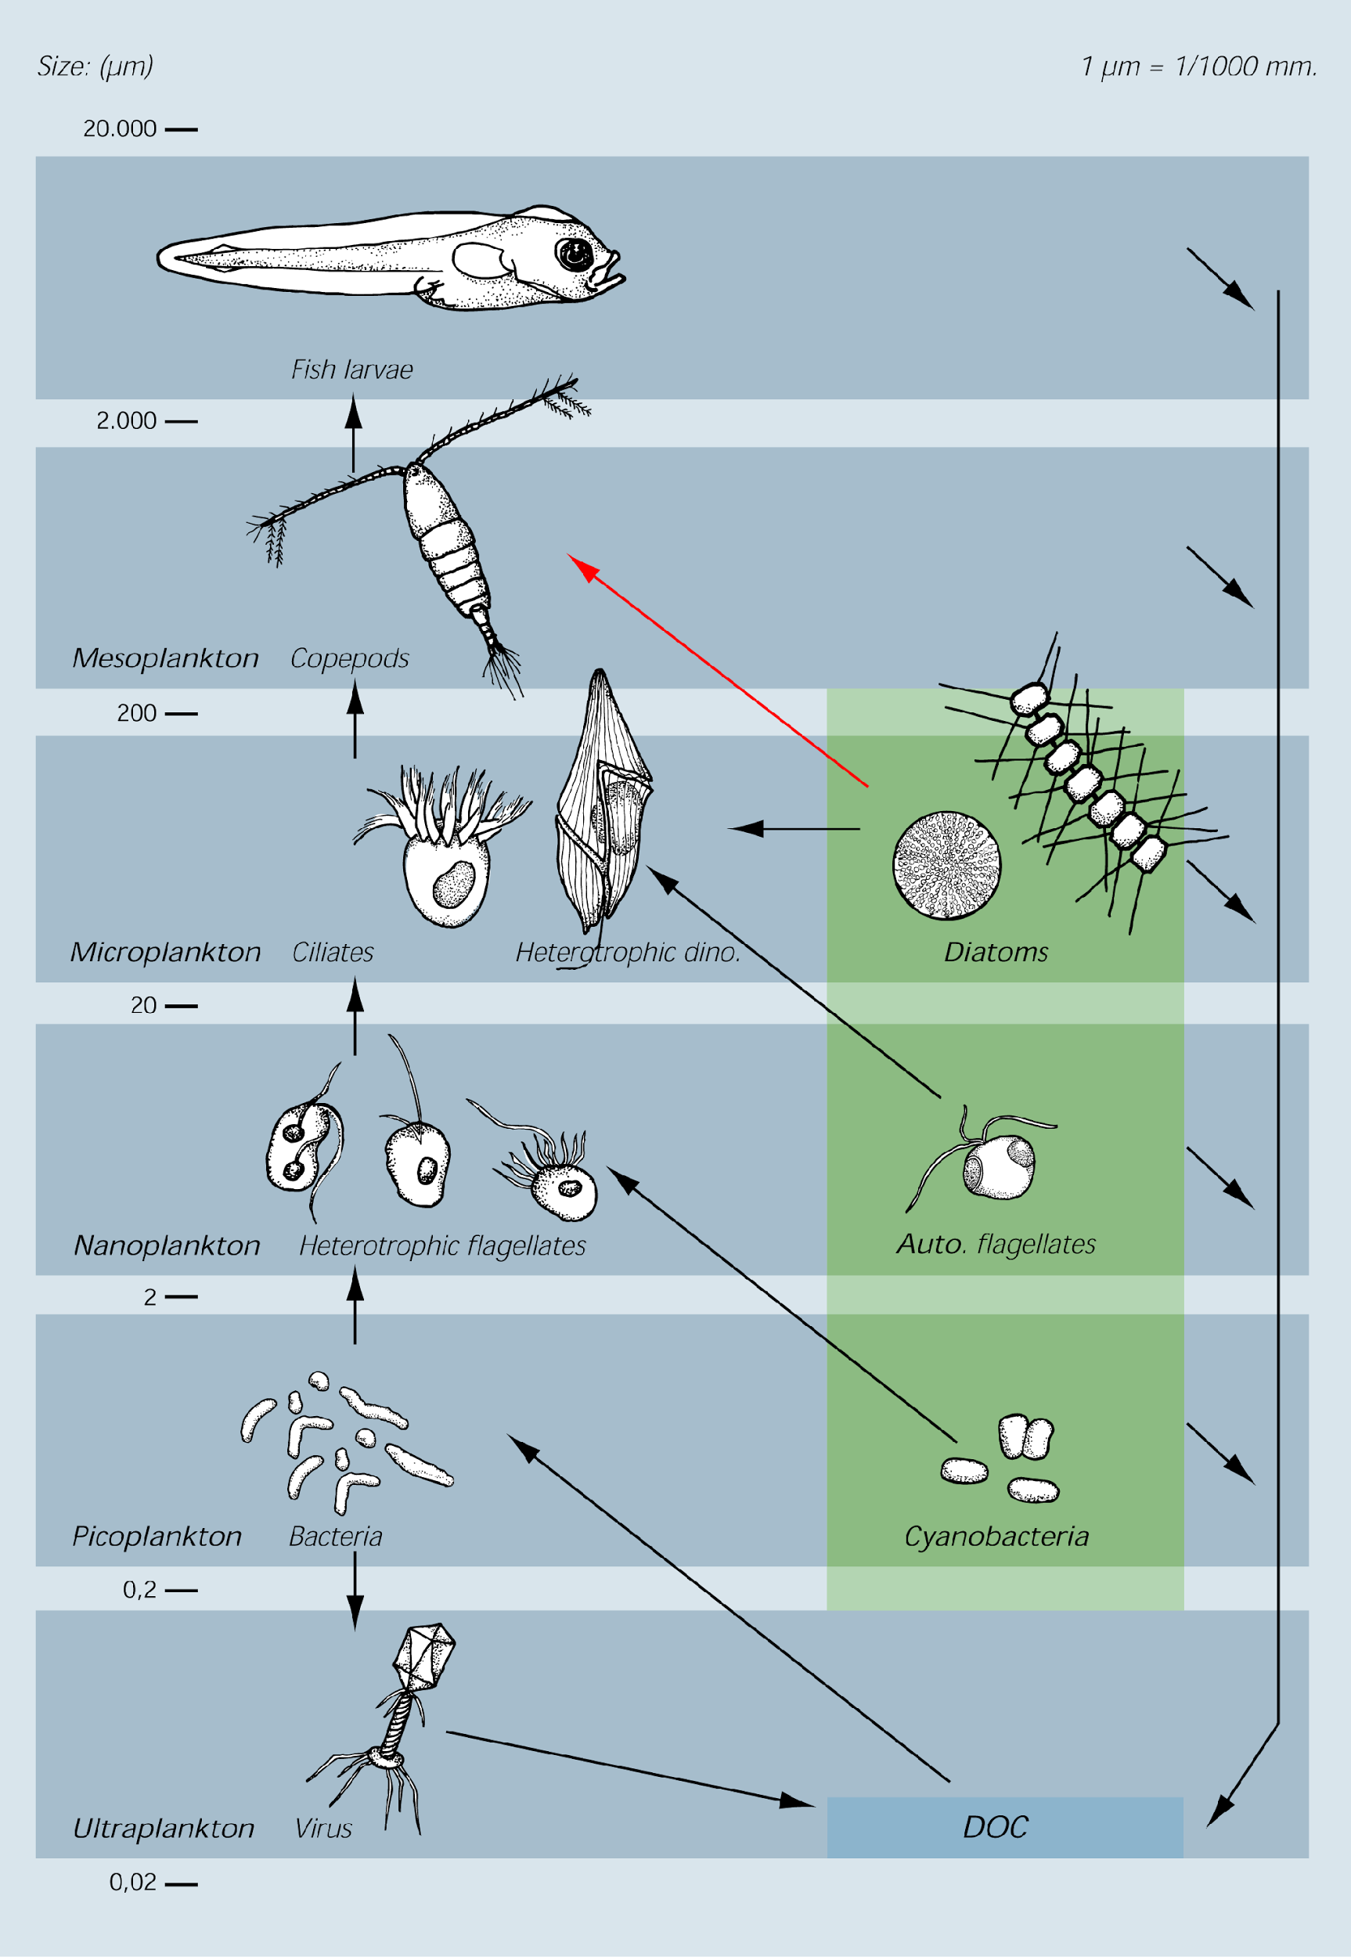
Bacteria
Dissolved
organic
carbon

Slide 5
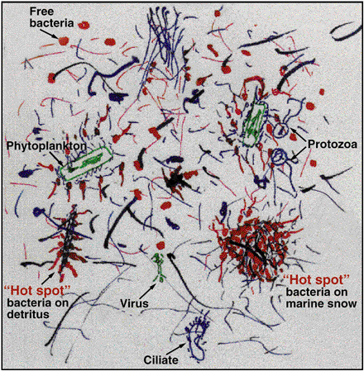
Näringskedjan i artistisk/realistisk tolkning
Azam 1998, Science 280:694-696

Slide 6
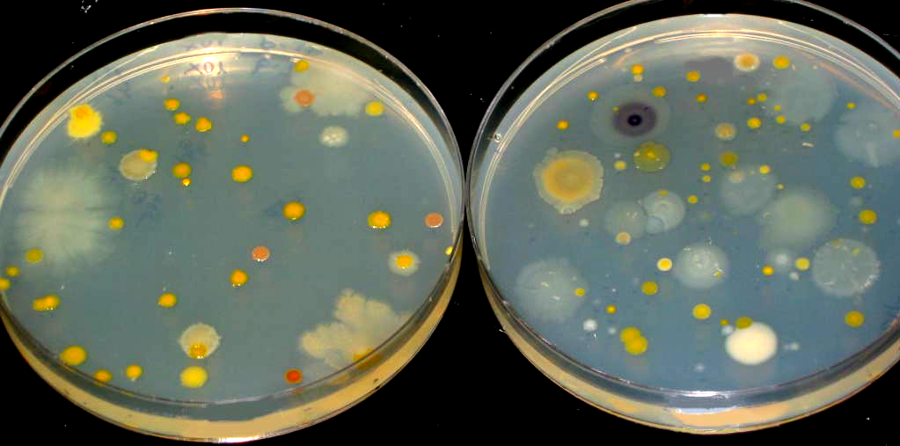
Biologisk mångfald bland marina bakterier
10x
100x
Bakteriekolonier på agarplattor – många olika färger…

Slide 7
What is a model organism?
A model bacterium can be a model in many ways…
As representative of a particular taxon (e.g. a genus or a family).
As representative of a particular process, it has (a set of) genes carrying out a certain ecological or physiological function.
As general representative of bacteria in general.
As representative of a ocean province.

Slide 8
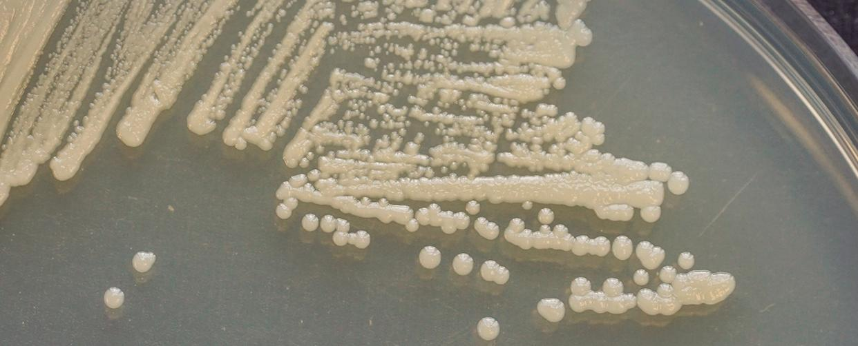
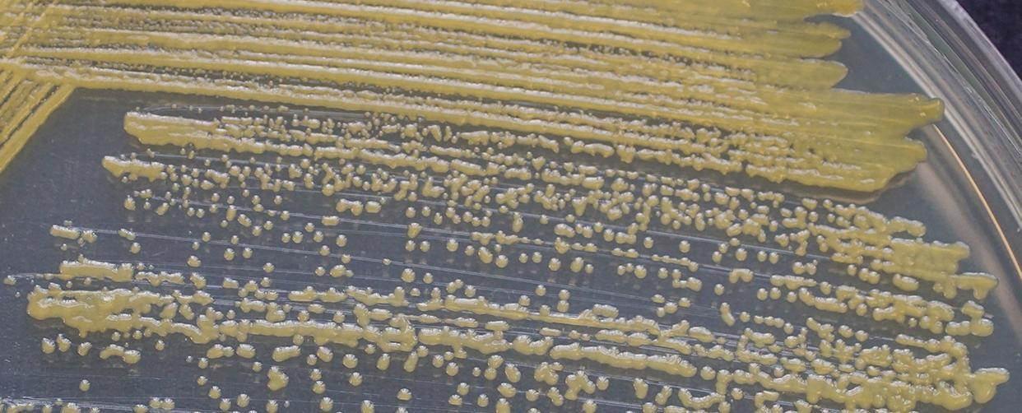
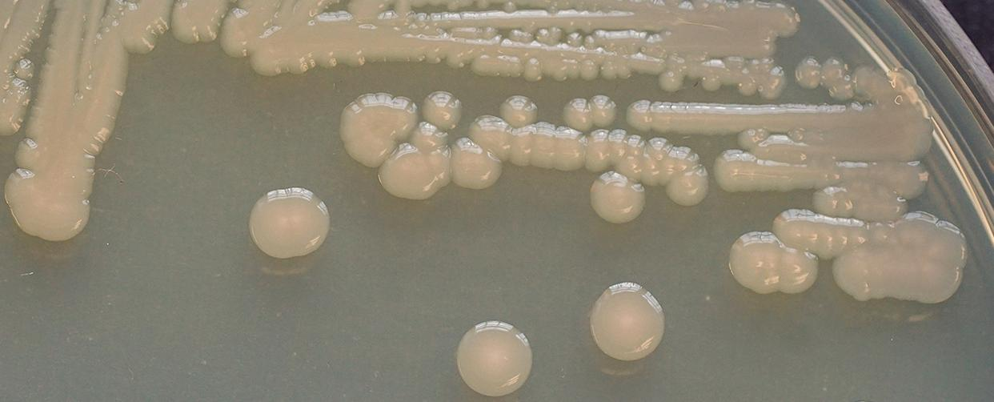
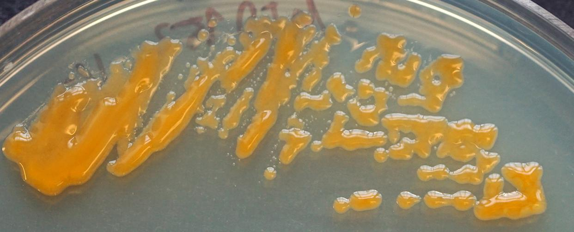
Examples of marine model bacteria
a. Ruegeria pomeroyi DSS-3
b. Dokdonia sp. MED134
c. Vibrio sp. AND4
d. Polaribacter sp. MED152
Photographs by Shalabh Sharma

Slide 9
Key model marine bacteria
Prochlorococcus spp. and Synechococcus spp. (Synechococcales, Cyanobacteria) (Chisholm et al. 1992; Partensky et al. 1999).
Candidatus Pelagibacter ubique HTCC1062 (Pelagibacterales, Proteobacteria) (Rappé et al. 2002).
Ruegeria pomeroyi DSS-3 (Rhodobacterales, Proteobacteria) (Moran et al. 2004).
Dokdonia sp. MED134 (Flavobacteriales, Bacteroidetes) (Gómez-Consarnau et al. 2007).
Nitrosopumilus maritimus (Nitrosopumilales, Thaumarchaeota) (Könneke et al. 2005).
Alteromonas macleodii (Alteromonadales, Proteobacteria) (Garcia-Martinez et al. 2002; Gauthier et al. 1995).

Slide 10
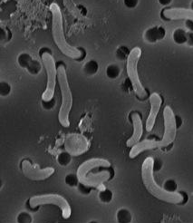
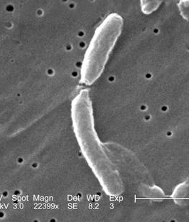
Schematic model of the oligotrophy‐copiotrophy life strategy continuum
Cand. Pelagibacter ubique HTCC1002
Flavobacterium johnsoniae UW101
Prochlorococcus marinus MIT9303
Roseobacter denitrificans OCh114
Pseudoalteromonas atlantica T6c
Dinoroseobacter shibae DFL12
Shewanella denitrificans OS217
Nitrosompumilus maritimus
Synechococcus sp. WH7803
Ruegeria pomeroyi DSS-3
Polaribacter sp. MED152
Nitrosomonas europaea
Vibrio fischeri ES114
SAR 11
Vibrio
Oligotrophy
Copiotrophy
Distribution considers slow growth, cell size, genome size, rRNA gene copies, treansporters, transcriptional regulators, metabolic versatility etc.
Lauro et al. 2009. Proc. Natl. Acad. Sci. USA, 2009. 106(37): p. 15527-15533

Slide 11
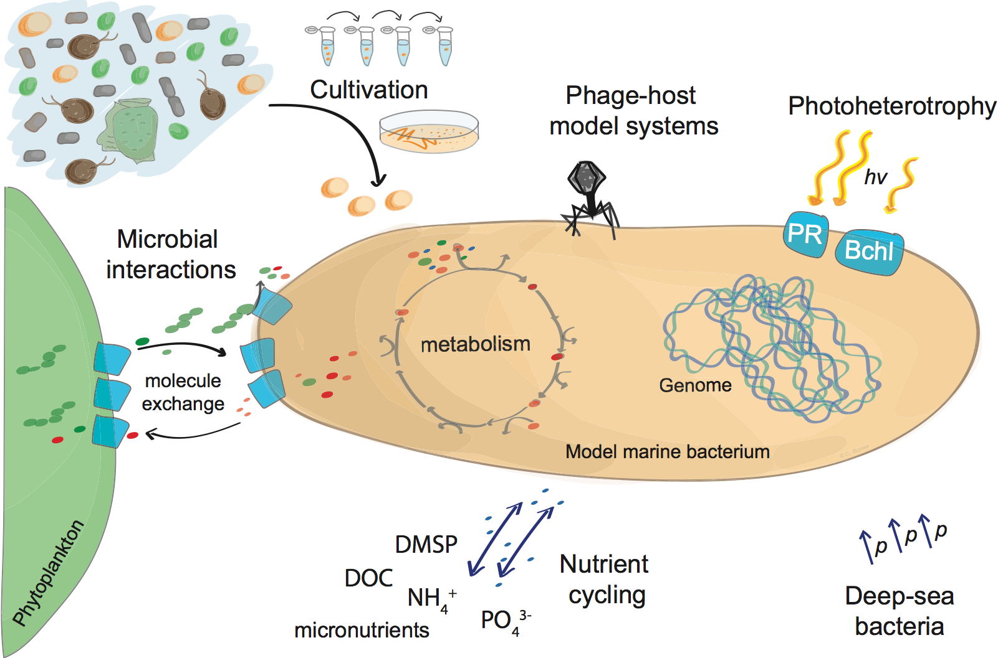
Topics studied using marine model bacteria
Image courtesy of Carina Bunse

Slide 12
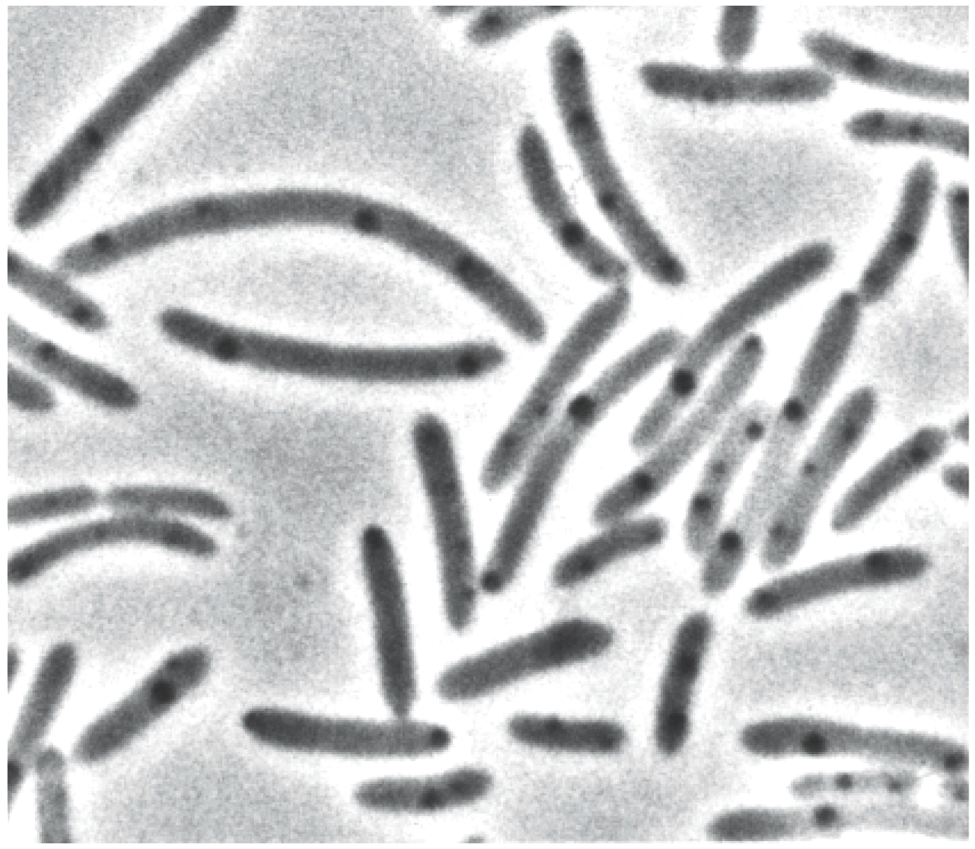
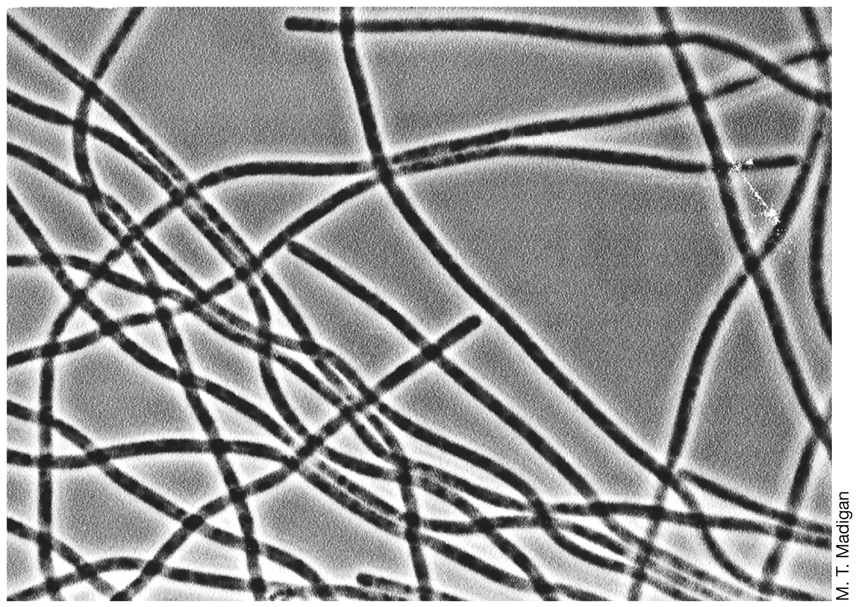
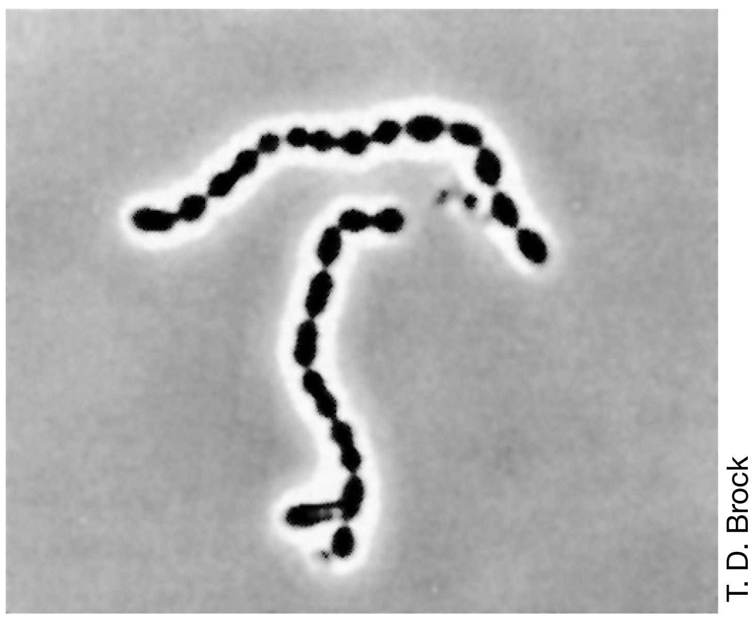
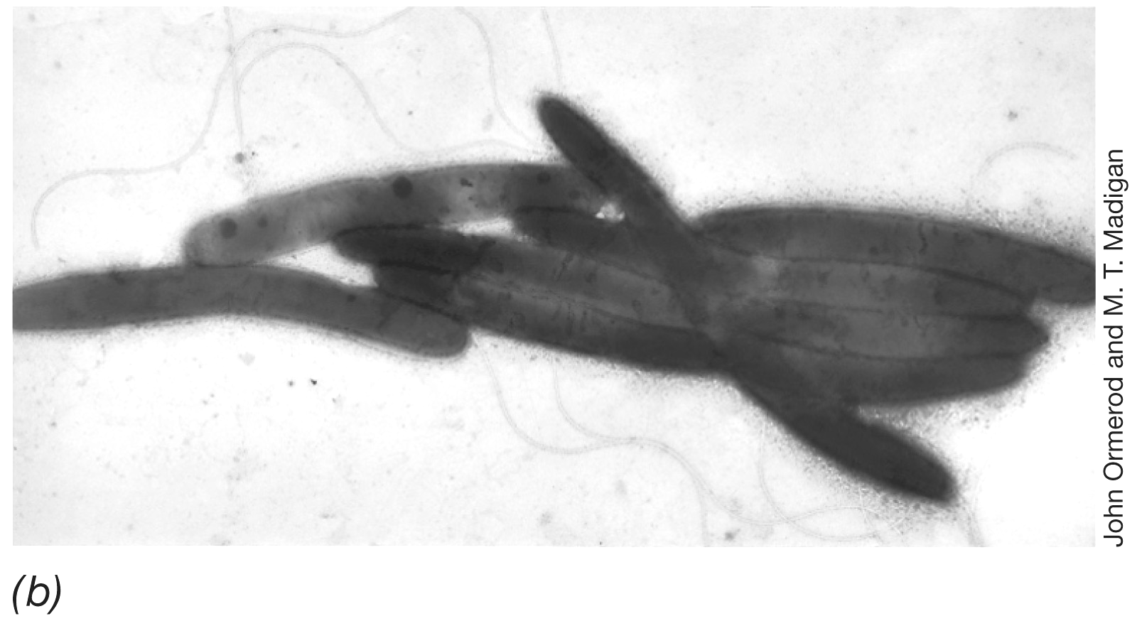
…och många olika former.
Bakterier sedda genom ljusmikroskop.

Slide 13
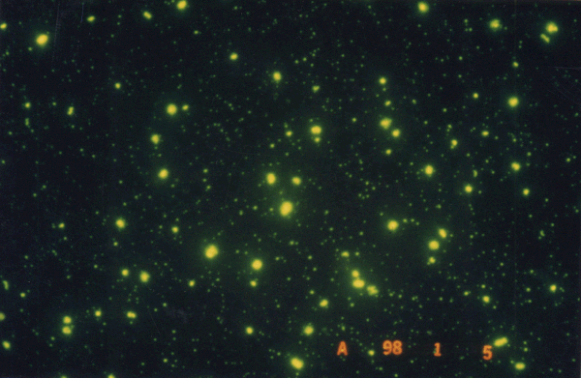
VIRUS OCH BAKTERIER I HAVET

Slide 14
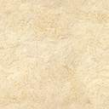
Aquifex aeolicus (Bacteria), Archaeoglobus fulgidus (Archaea), Aerop-yrum pernix (Archaea), Methanothermobacter thermautotrophicus (Archaea), Methanococcus jannaschii (Archaea), Pyrococcus horikoshii (Archaea), Sulfolobus solfataricus (Archaea), Thermoplasma acidop-hilum (Archaea), Thermoplasma volcanium (Archaea), Thermotoga maritima (Bacteria), Pyrobaculum aerophilum (Archaea), Pyrococcus abyssii (Archaea), Pyrococcus furiosus (Archaea), Thermus thermo-philus (Bacteria), Aquifex aeolicus (Bacteria), Archaeoglobus fulgidus (Archaea), Aeropyrum pernix (Archaea), Methanothermobacter ther-mautotrophicus (Archaea), Methanococcus jannaschii (Archaea), Pyro-coccus horikoshii (Archaea), Sulfolobus solfataricus (Archaea), Ther-moplasma acidophilum (Archaea), Thermoplasma volcanium (Archa-ea), Thermotoga maritima (Bacteria), Pyrobaculum aerophilum (Arch-aea), Pyrococcus abyssii (Archaea), Pyrococcus furiosus (Archaea), Thermus thermophilus (Bacteria) Thermus thermophilus (Bacteria), Aquifex aeolicus (Bacteria), Archaeoglobus fulgidus (Archaea), Aero-pyrum pernix (Archaea), Methanothermobacter thermautotrophicus (Archaea), Thermotoga maritima (Bacteria), Pyrobaculum aerophilum (Archaea), Sulfolobus solfataricus (Archaea), Thermoplasma acidop-
Mikroorganismer är anpassade till alla tänkbara (och otänkbara!) levnadsmiljöer på Jorden.
Denna biologiska mångfald är förutsättningen för att vi idag kan erhålla nyttiga produkter från dessa varelser:
Etanol, vätgas, metan, enzymer, antibiotika, ost, yoghurt, öl, etcetera…

Slide 15
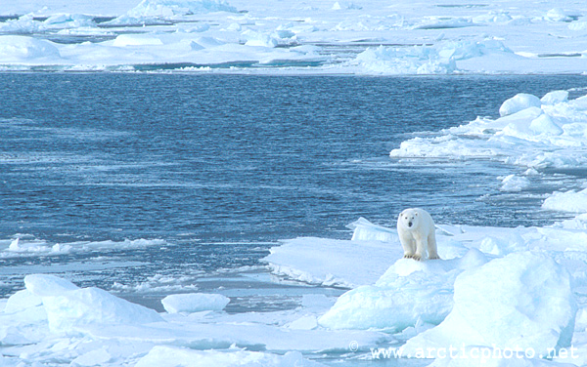
Köld är inget hinder för bakterier...

Slide 16
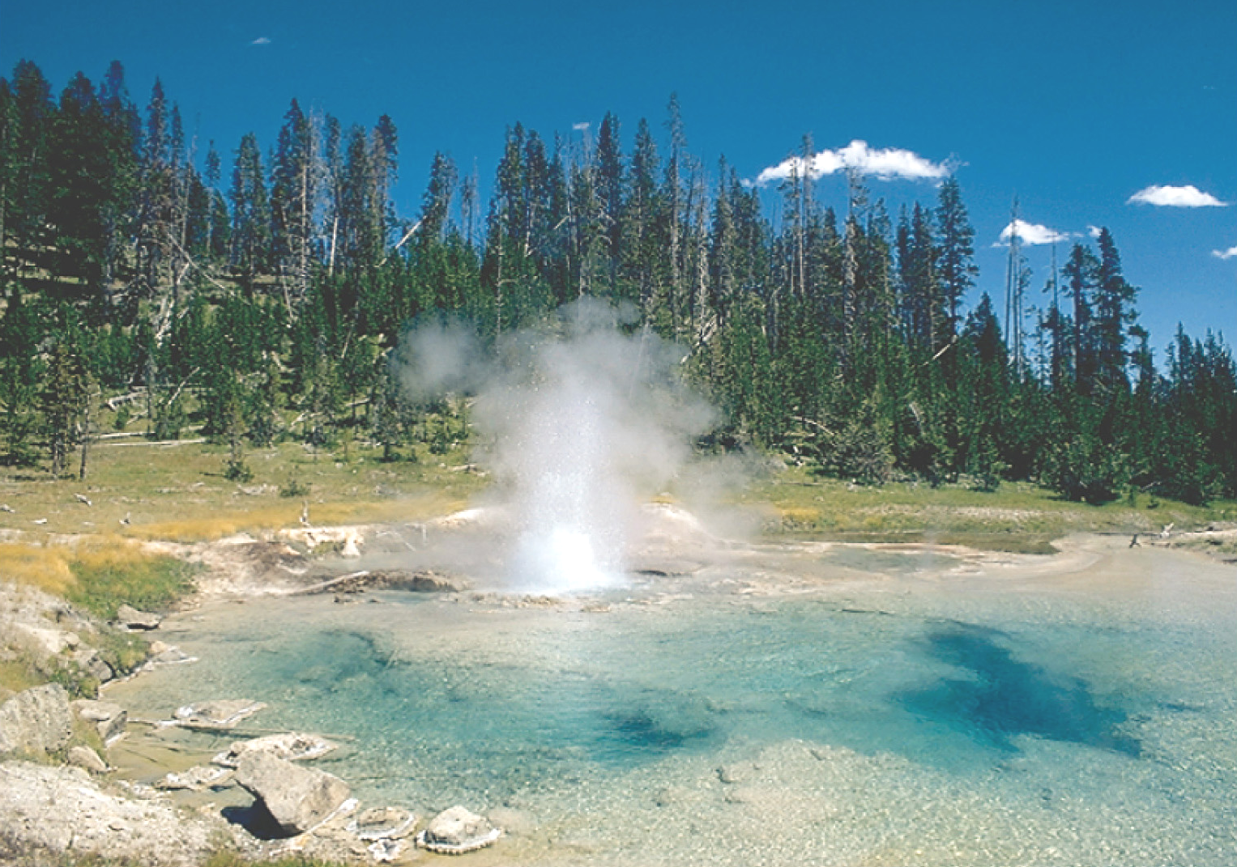
...inte heta källor heller!
En förutsättning är förmågan att kunna anpassa sig!.

Slide 17
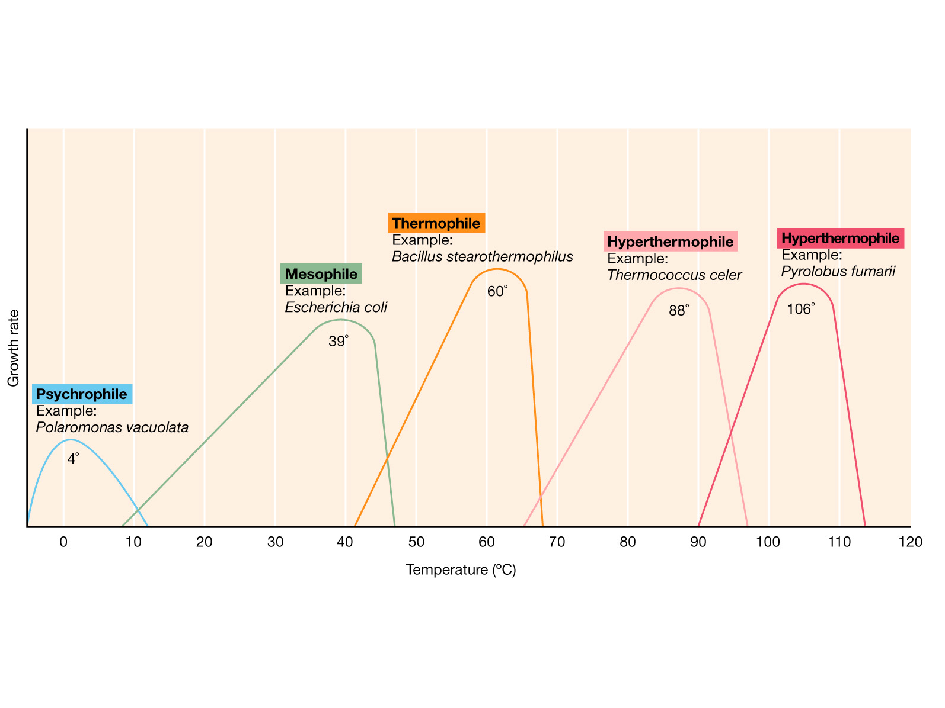
Det finns bakterier anpassade att växa vid temperaturer mellan -2 till +114°c
Tillväxthastighet
Temperatur
Alltså kan de trivas från antarktis iskalla vatten till Islands heta källor

Slide 18
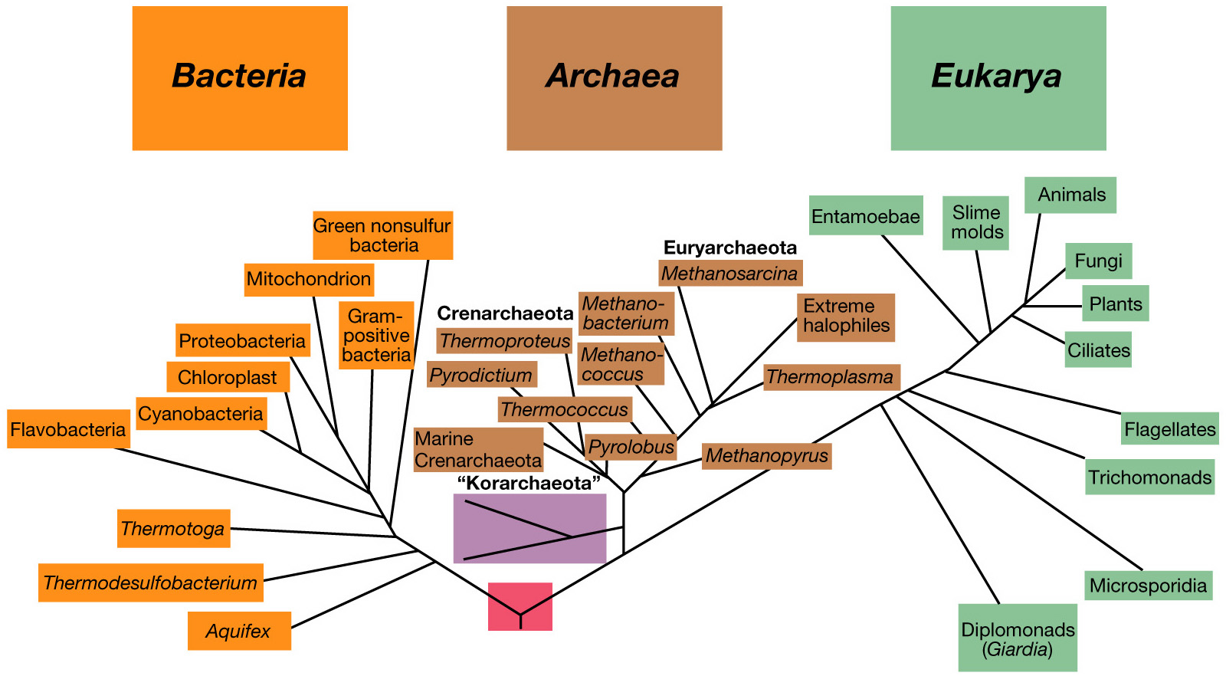
Livets släktträd
Vi är här
Bakterier utgör en enorm bank av biologisk mångfald

Slide 19
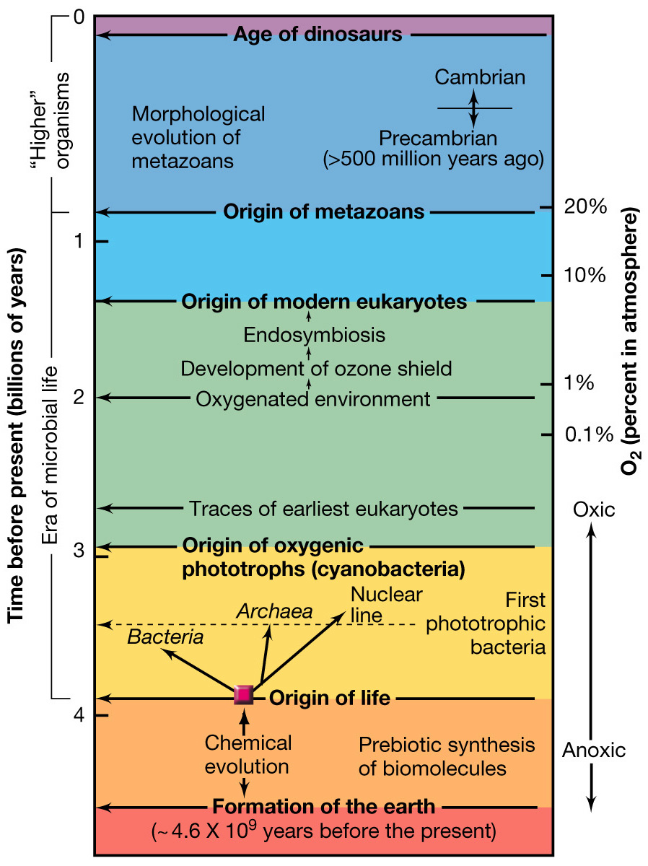
När uppstod olika livsformer på Jorden?

Slide 20
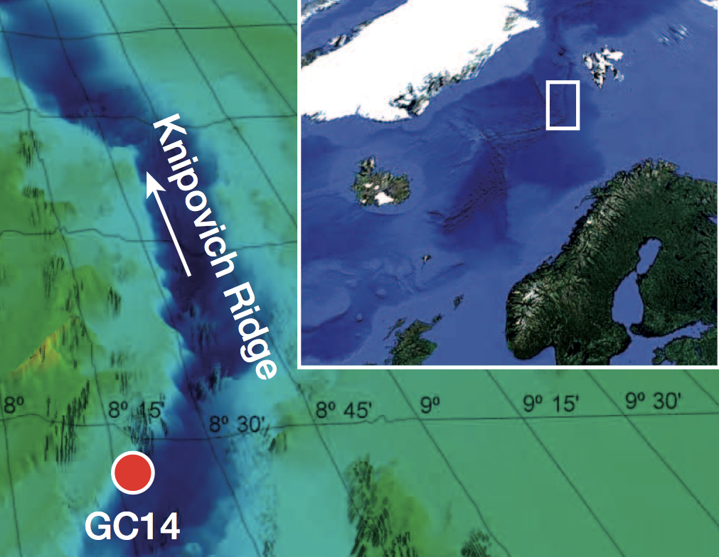
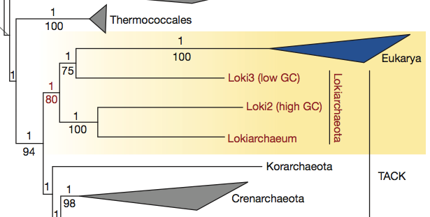
Marine microorganisms – leads toward uncovering the evolutionary history of present life forms
Arctic Ocean Archaea bridge the gap between prokaryotes and eukaryotes.
Spang et al. Nature 2015

Slide 21
The question in marine microbial ecology...
We have a relatively good idea of how bulk microbial processes shape the cycling of organic matter and nutrients in the sea.
We know much about the diversity of marine bacterioplankton.
We only recently began to understand the spatial and temporal distribution of specific bacteria,
and about the molecular mechanisms that determine their role in biogeochemical cycles.
Notes:
We don’t know who do what, or how they do it!

Slide 22
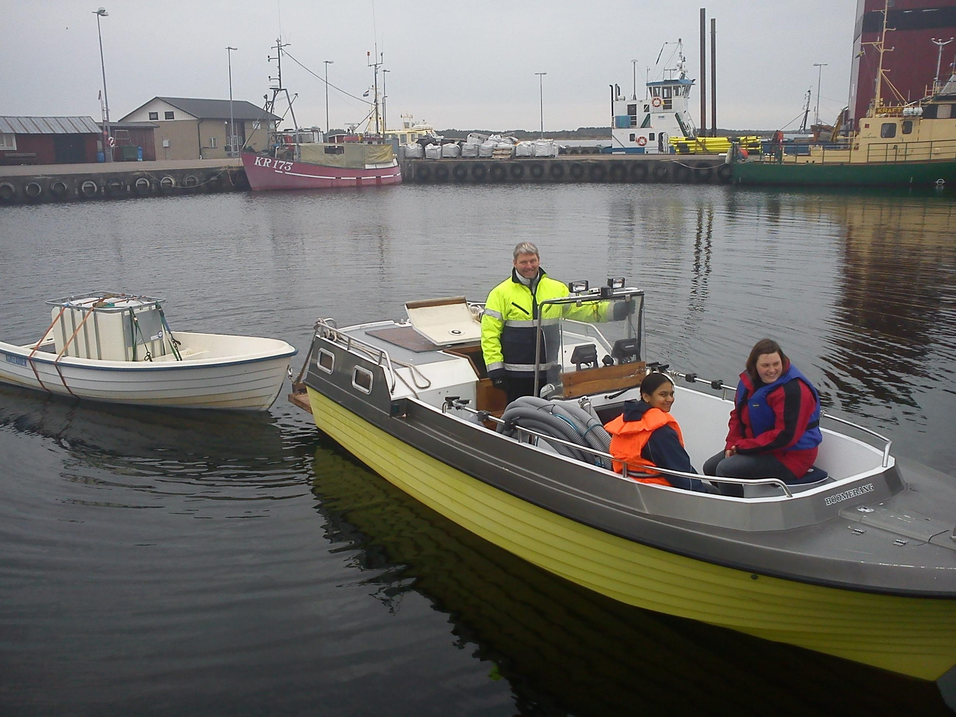
Sampling – not always a piece of cake…

Slide 23
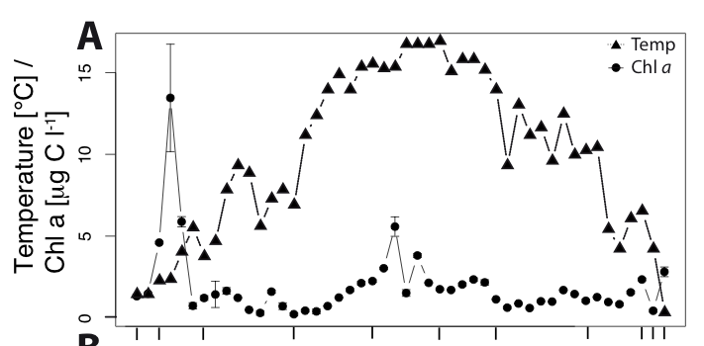
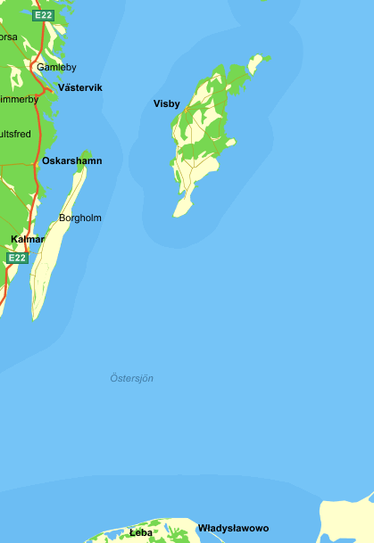
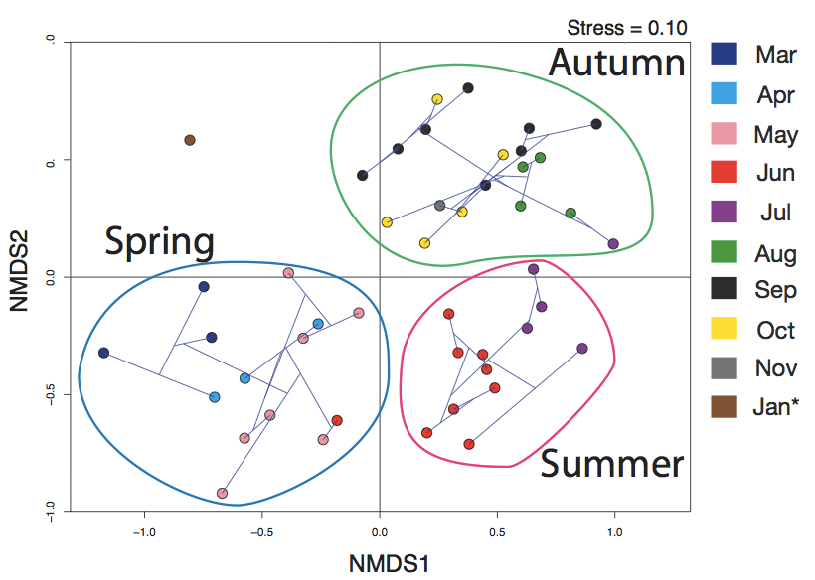
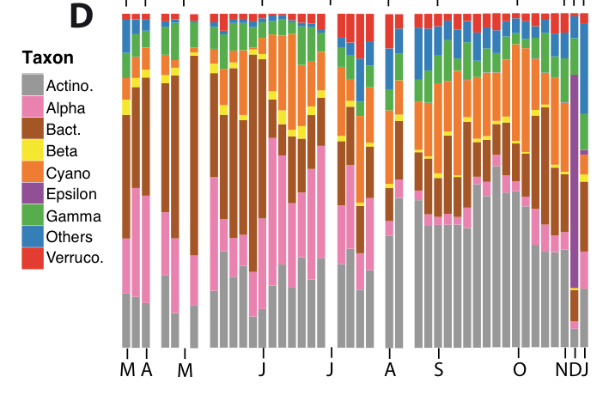
Linnaeus Microbial Observatory (LMO)
Lindh et al. Environ Microbiol 2015

Slide 24
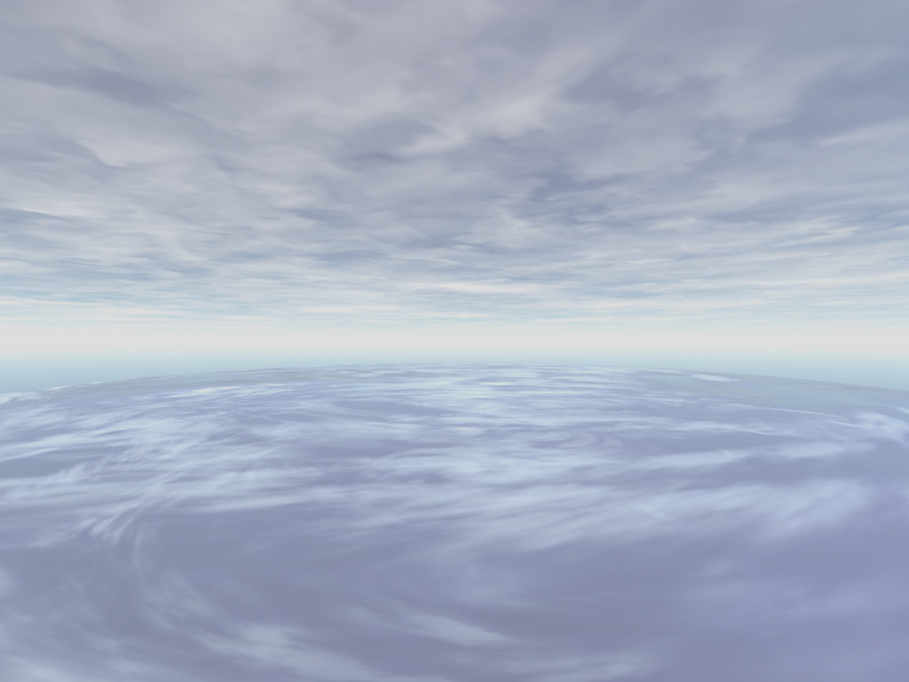
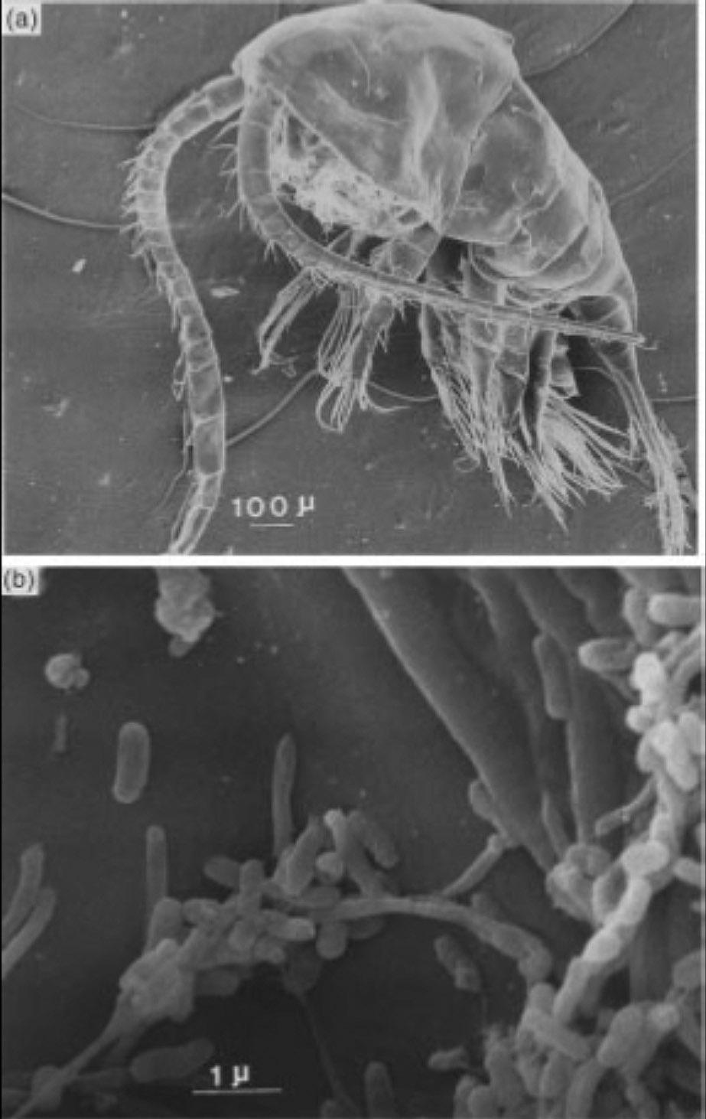
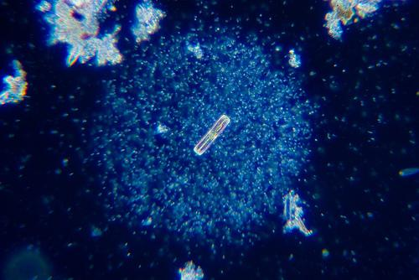
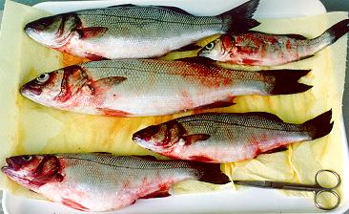
Äter marina bakterier flercelliga organismer?

Slide 25
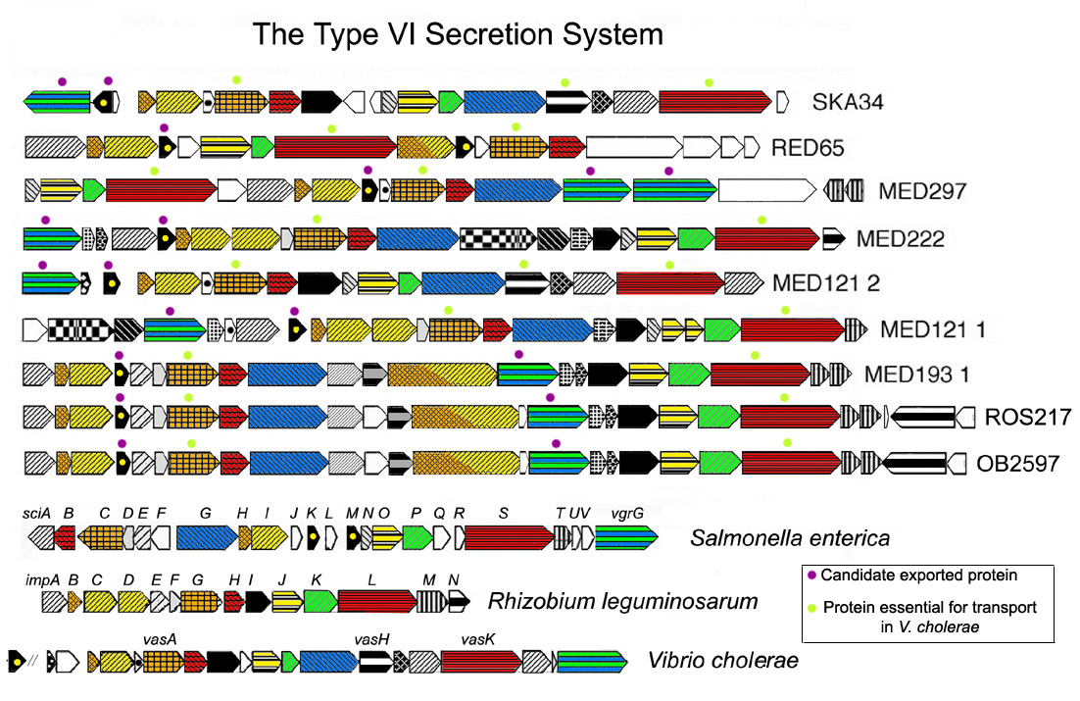
Virulensgener hos marina bakterier
Virulensgener finns hos 60 av 119 bakterier som har sekvenserats (med kartlagd arvsmassa).
Notes:
- Found in most animal and human pathogens.
Marine Gamma-proteobugs:
Photobacterium SKA34 the one with the toxin islands, Marinomonas MED121 (x2), Oceanobacer RED65, Vibrio MED222, Reinekea MED297
Marine Alpha-proteobugs:
MED193 Roseobacter, Roseovarius 217, Oceanicola batsensis

Slide 26
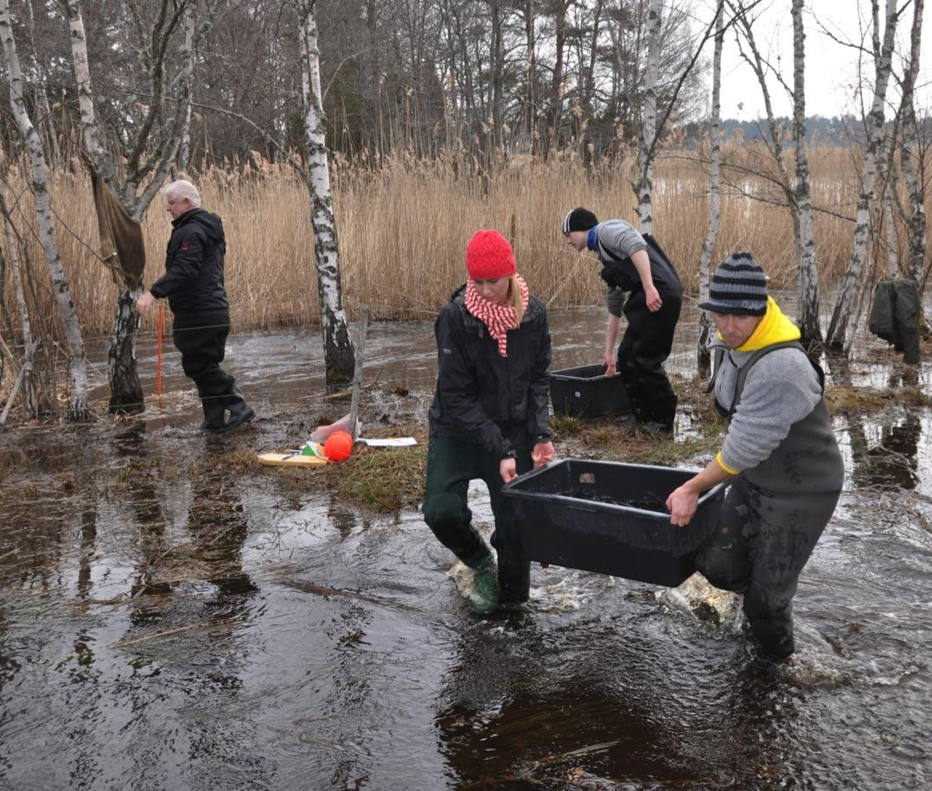
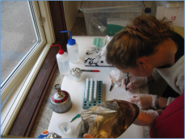
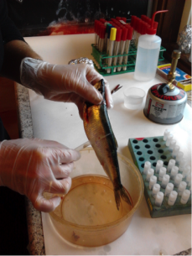
Exempel på ny ämnesöverskridande forskning: samspel mellan fisk och mikrober.

Slide 27
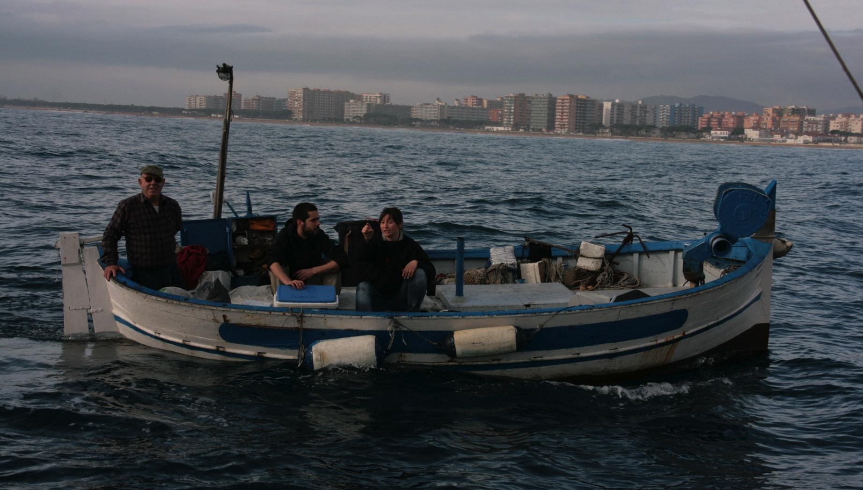

Slide 28
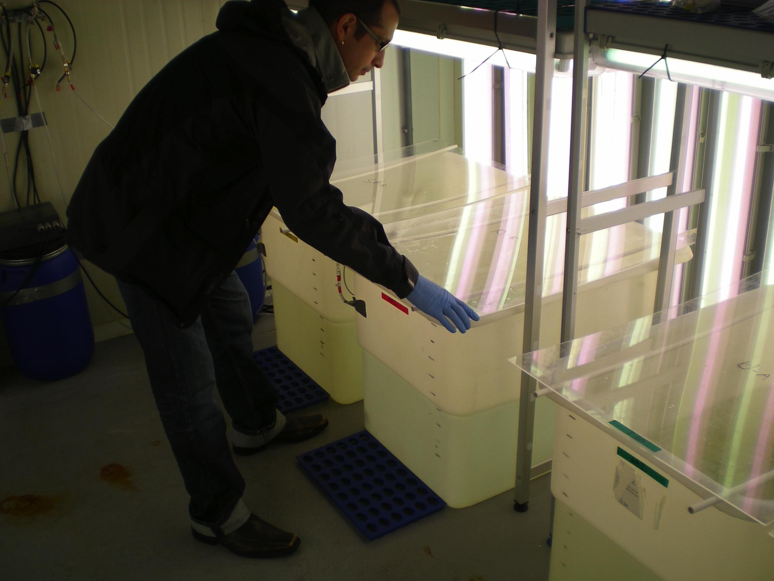
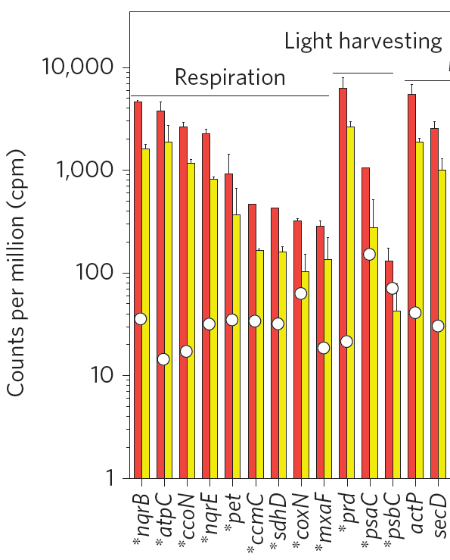
Challenging marine bacteria with ocean acidification
Proteorhodopsin
Acidification triggers pronounced responses in expression of
pH homeostasis genes,
and also rhodopsins!
Bunse et al. 2016. Nature Climate Change

Slide 29
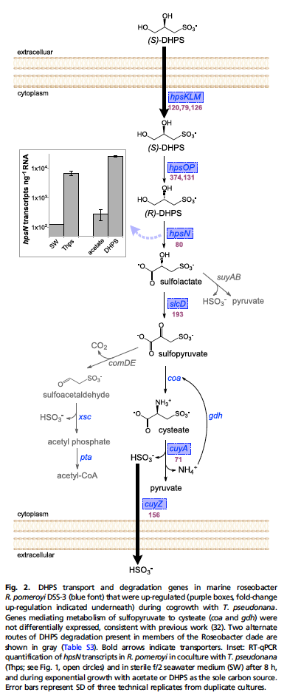
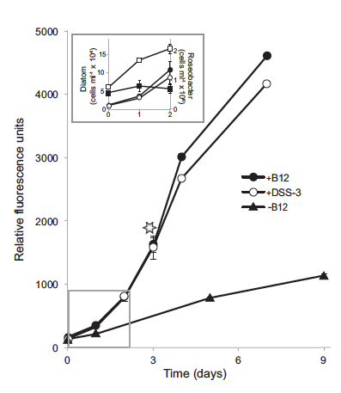
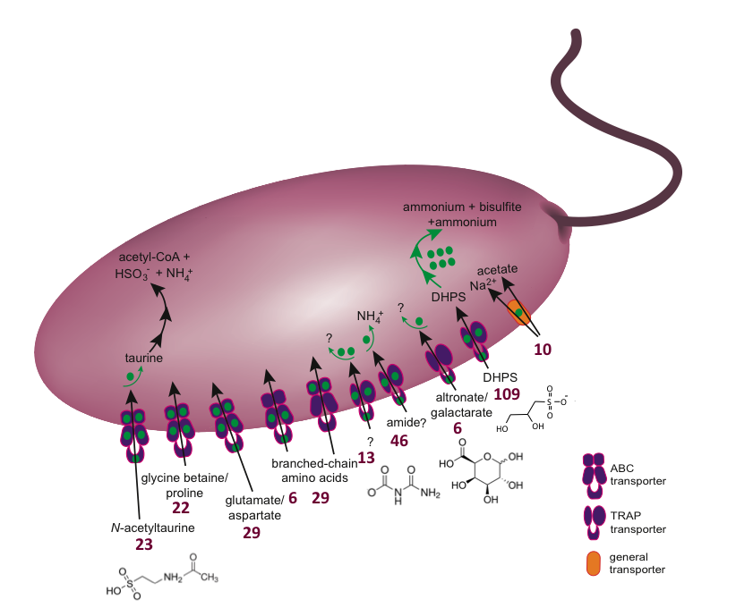
Tjänster och gentjänster mellan celler och organismer
a
b
Co-culturing the diatom Thalassiosira pseudonana and the bacterium Ruegeria pomeroyi.
Durham et al. PNAS. 2015

Slide 30
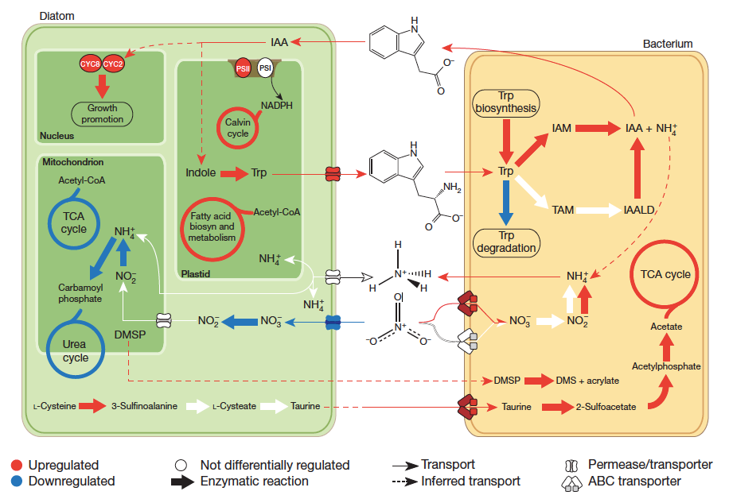
Växthormoner bland mikrober?!
Model of Pseudo-nitzschia multiseries–Sulfitobacter interactions based on transcriptomic and targeted metabolite analyses (the hormone indole-3-acetic acid). Amin et al. 2015. Nature.

Slide 31
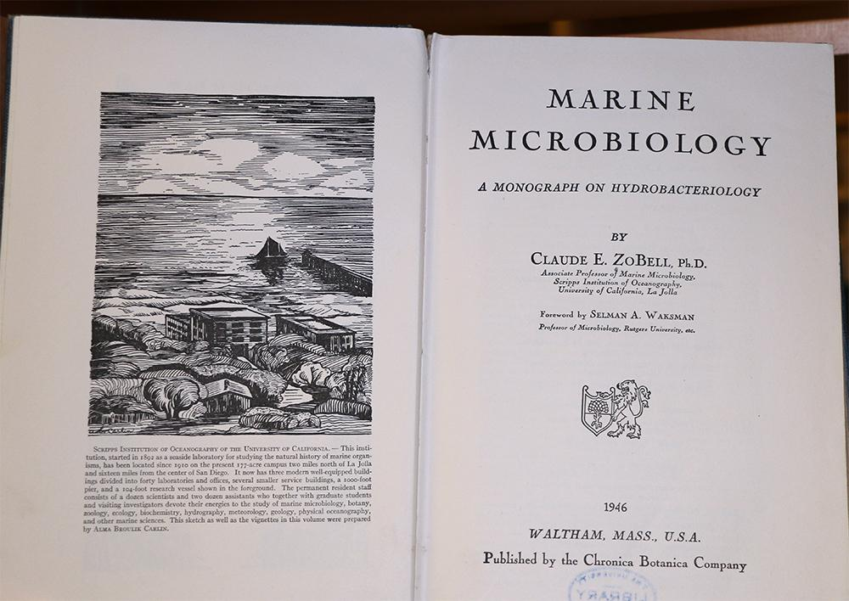
“There are very few questions regarding the science of the sea which can be satisfactorily answered without due consideration of bacteria.”
Claude E. ZoBell, 1946

